Slide 1
CHAPTER 1: Introduction to Digital Design

Slide 2
Syllabus
Week | Content | Notes
1 | Chapter 0: Course Introduction (1) Chapter 1: Introduction to Digital Design (2)
2 | Chapter 2: Overview of HDL (3)
3 | Chapter 3: Basic Language Constructs of VHDL (3)
5, 6 | Chapter 4: Signal Assignment Statements of VHDL (6)
6 | Chapter 5: Combinational Logic Circuit Design (3)
7 | Midterm Exam (2)
8 | Chapter 6: Sequential Logic Circuit Design (3)
9, 10 | Chapter 7: Finite State Machine (FSM) Principle (6)

Slide 3
Content
Introduction
Device Technology
System Representation
Level of Abstraction
Development Tasks and EDA Software
Flow Development

Slide 4
1. Introduction
Digital hardware has experienced drastic expansion and improvement in the past 40 years.
Since the number of transistors in a single chip has grow exponentially.
  Follow the Moore’s Law
A silicon chip now routinely contains hundreds of thousands or even hundreds of millions of transistors.

Slide 5
1. Introduction
In the past, the major applications of digital hardware were computational systems.
However, as the chip become smaller, faster, cheaper and more capable, many electronic, control, communication and even mechanical systems have been “digitized” internally, using digital circuits to store, process, and transmit information.
As applications become larger and more complex, the task of designing digital circuits become more difficult.
Developing and producing a digital circuit is a complicated process, and the design and synthesis are only two of the tasks.

Slide 6
2. Device Technologies
If we want to build a custom digital system, there are varieties of device technologies to choose.
There is no single best technology.
We have to consider the trade-offs among various factors, including chip are, speed, power, and cost.
To better understand the differences between the device technologies, it is helpful to have a basic idea of the fabrication process of an integrated circuit.

Slide 7
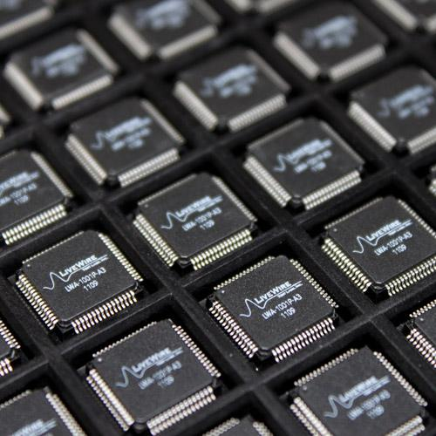
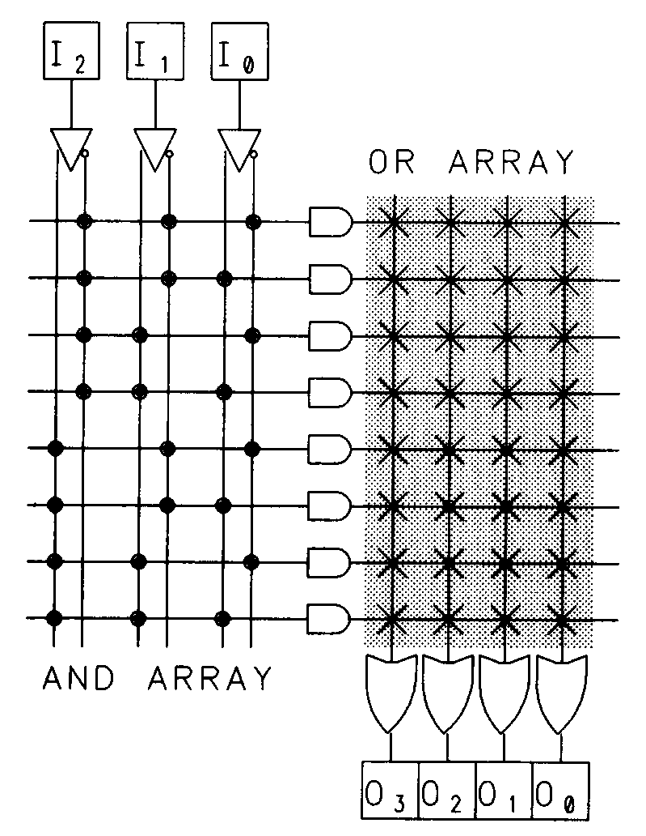
2. Device Technologies
ASICs – Application Specific Integrated Circuit
  Any IC chip that was designed for solving a specific problem. Example: multiplexer, screen displaying, controller, …
  ASICs chip CAN NOT change its functionality production
  Full-custom ASIC
  Standard-cell ASIC
  Gate array ASIC
PLD – Programmable Logic Devices
  IC chip that DOES NOT perform any specific function
  Instead, its function can be changed by users
  Complex field-programmable logic device
  Simple field-programmable logic device

Slide 8
2. Device Technologies
Full-custom ASIC
  We have complete control of the circuit and can even craft the layout of a transistor to meet special area or performance needs.
  The resulting circuit is fully optimized and has the best possible performance.
  Unfortunately, designing a circuit at the transistor level is extremely complex and involved, and is only feasible for a small circuit.
  It is not practical to use this approach to design a complete system, which now may contain tens and even hundreds of millions of transistors.

Slide 9
2. Device Technologies
Full-custom ASIC
  The major application of full-custom ASIC technology is to design the basic logic components that can be used as building blocks of a larger system.
  Another application is to design special-purpose “bit-slice” typed circuits, such as a 1-bit memory or 1-bit adder.
  These circuits have a regular structured are constructed through a cascade of identical slices.
  To obtain optimal performance, full-custom ASIC technology is frequently used to design a single slice.
  The slice is then replicated a number of times to form a complete circuit.

Slide 10
2. Device Technologies
Standard-cell ASIC
  A circuit is constructed by using a set of predefined logic components, knows as standard cells.
  These cells are predesigned and their layouts are validated and tested.
  Standard-cell ASIC technology allows us to work at the gate level rather than at the transistor level and thus greatly simplifies the design process.
  The device manufacturer usually provides a library of standard cells as the basic building blocks.

Slide 11
2. Device Technologies
Standard-cell ASIC
  The library normally consists of basic gates, simple combinational components, such as
    2-to-1 multiplexer
    1-bit full adder
    And-or-inverter
  And basic memory elements, such as
    D-type latch
    D-type flip-flop
  Some libraries may also contain more sophisticated function blocks, such as an adder, barrel shifter and random access memory (RAM).

Slide 12
2. Device Technologies
Gate array ASIC
  In standard-cell technology, a circuit is made of cell.
  The types of cells and the interconnection depend on the individual application.
  In gate array ASIC technology, a circuit is built from an array of predefined cells.
  Unlike standard-cell technology, a gate array chip consists of only one type of cell, known as a base cell.
  The base cell is fairly simple, resembling a logic gate
  Base cells are prearranged and placed in fixed positions, aligned as a one- or two-dimensional array.

Slide 13
2. Device Technologies
Gate array ASIC
  Since the location and type are predetermined, the base cells can be prefabricated.
  The customization of a circuit is done by specifying the interconnect between these cells.
  A gate array vendor also provides a library of predesigned components, known as macro cells, which are built from base cells.
  The macro cells have a predefined interconnect and provide the designer with more sophisticated logic blocks.

Slide 14
2. Device Technologies
Gate array ASIC
  Compare to standard-cell technology:
    The fabrication of a gate array device is much simpler, due to its fixed array structure
    Since the array is common to all applications, the cell can be fabricated in advanced
  During construction of a chip, only the masks of metal layers, which specify the interconnect, are unique for an application and therefore must be customized.
  This reduces the number of custom layers from 10 to 15 layers to 3 to 5 layers and simplifies the fabrication process significantly.

Slide 15
2. Device Technologies
Complex field-programmable device
  We now examine several non-ASIC technologies
  The most versatile non-ASIC technology is the complex field-programmable device.
  A device consists of an array of generic logic cells and general interconnect structure.
  Although the logic cells and interconnect structure are prefabricated, both are programmable.
  The programmability is obtained by utilizing semiconductor “fuse” or “switches”, which can be set as open- or short-circuit.

Slide 16
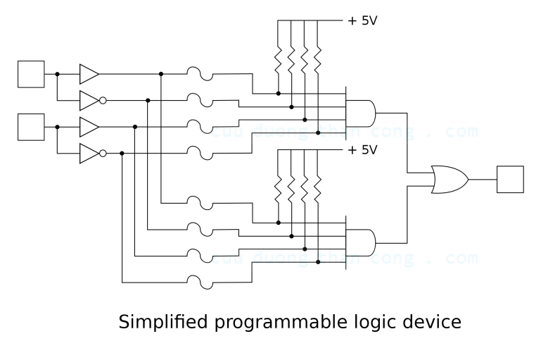
2. Device Technologies
Complex field-programmable device

Slide 17
2. Device Technologies
Complex field-programmable device
  The customization is done by configuring the device with a specific fuse pattern.
  This process can be accomplished by a simple, inexpensive device programmer, normally constructed as an add-on card or an adaptor cable of a PC.
  Since the customization is done “in the field” rather than “in fab”, this technologies is known as field programmable.
  (In contrast, ASIC technologies are “programmed” via one or more tailored masks and thus are mask programmable)

Slide 18
2. Device Technologies
Complex field-programmable device
  The basic structures of gate array ASIC and complex filed-programmable devices are somewhat similar.
  However, the interconnection structure of field-programmable devices is predetermined and thus imposes more constraints on signal routing.
  To reduce the amount of connection, more functionality is built into the logic cells of a field-programmable device, making a logic cell much more complex than a base cell of a standard cell of ASIC.
  Based on the complexity and structure of logic cells, there are two categories:
    Complex Programmable Logic Device (CPLD)
    Field-programmable Gate Array (FPGA)

Slide 19
2. Device Technologies
Complex field-programmable device
  The logic cell of a CPLD device is more sophisticated, normally consisting of a D-type flip-flop and a PAL-like unit with configurable product terms.
  The interconnect structure of a CPLD device tends to be more centralized, with few groups of concentrated routing lines.

Slide 20
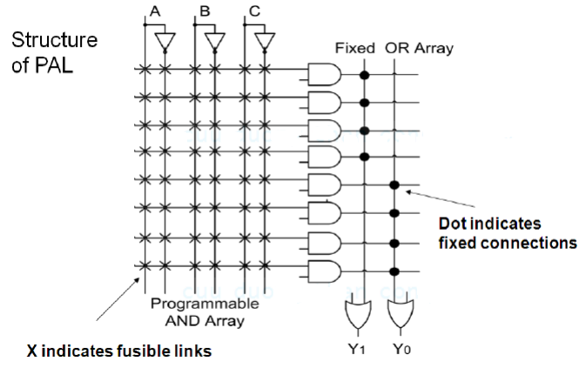
2. Device Technologies
Complex field-programmable device

Slide 21
2. Device Technologies
Complex field-programmable device
  On other hand, the logic cell of an FPGA device is usually smaller, typically including a D-type flip-flop and a small look-up table or a set of multiplexers.
  The interconnect structure between the cell tends to be distributed and more flexible.
  Because of its distributive nature, FPGA is better suited for large, high-capacity complex field-programmable devices.

Slide 22
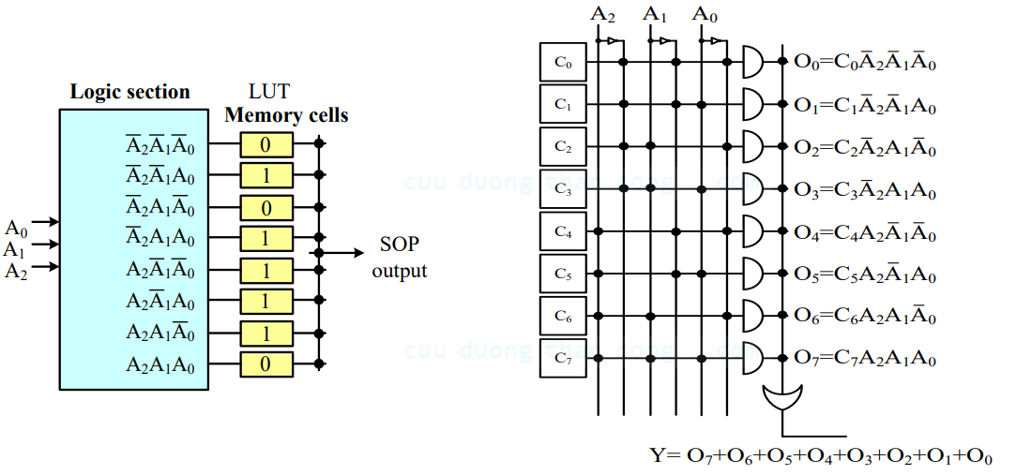
2. Device Technologies
Complex field-programmable device

Slide 23
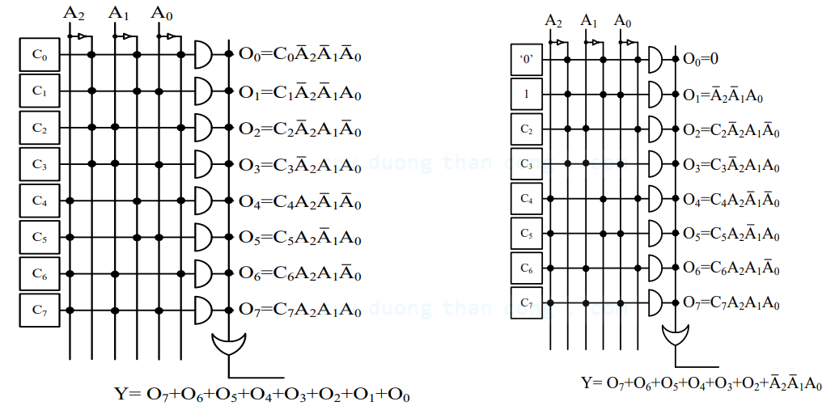
2. Device Technologies
Complex field-programmable device

Slide 24
2. Device Technologies
Simple field-programmable device
  Simple field-programmable logic devices are programmable devices with simpler internal structure.
  These devices are generically called programmable logic devices (PLDs)
  We add the word simple to distinguish them from FPGA and CPLD devices.
  Simple field-programmable devices are normally constructed as a two-level array, with an AND plane and an OR plane.
  The interconnect of one or both planes can be programmed to perform a logic function expressed in sum-of-product format.

Slide 25
2. Device Technologies
Simple field-programmable device
  Programmable read only memory (PROM), in which the OR plane can be programmed.
  Programmable array logic (PAL), in which the AND plane can be programmed.
  Programmable logic array (PLA), in which both planes can be programmed.

Slide 26
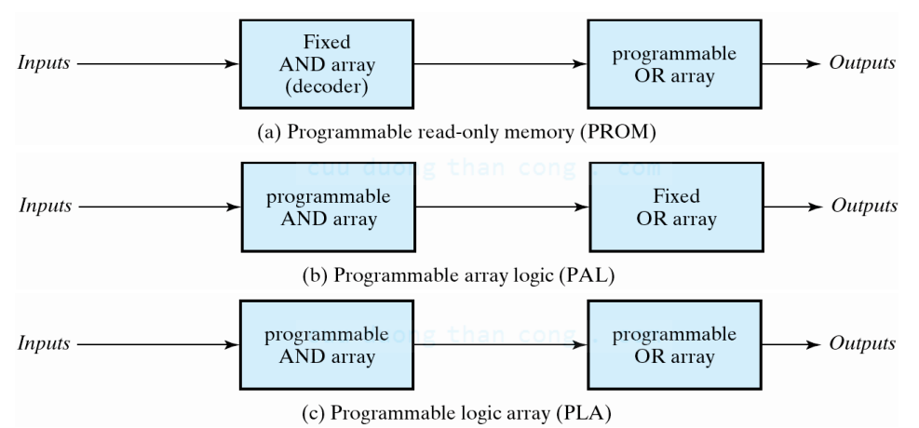
2. Device Technologies
Simple field-programmable device

Slide 27
2. Device Technologies
Comparison of Technologies
  Once deciding to develop custom hardware for an application, we need to choose from the three device technologies.
  The major criteria for selection are area, speed, power, and cost.
  Chip area (or size) corresponds to the required silicon real estate to implement a particular application.
  In general, a gate array chip may need 20% to 100% larger silicon area than that of a standard-cell chip, but an FPGA chip frequently require two or five times the area of an ASIC chip.
  Speed means the propagation delay.
  Similarly to chip area, standard-cell chip has the smallest propagation delay, while FPGA chip has worst delay.

Slide 28
2. Device Technologies
Comparison of Technologies
  Power: If the identical architecture is used, a smaller chip, which consists of fewer transistors, usually consumes less power.
  Thus, a standard-cell chip consumes the least amount of power and an FPGA chip uses the most power.
  However, designing and fabricating a standard-cell chip is more involve and time consuming than for other technologies.

Slide 29
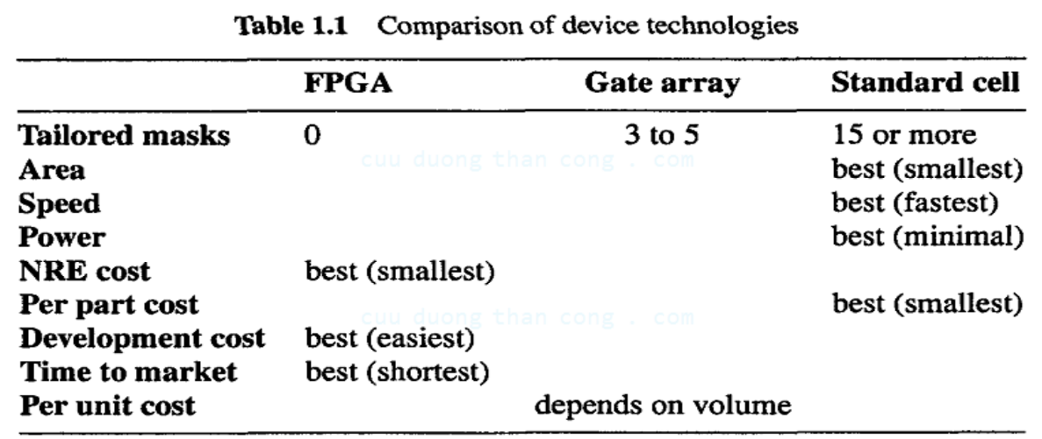
2. Device Technologies
Comparison of Technologies

Slide 30
3. System Representation
A large digital system is quite complex
The same system is frequently described in different ways and is examined from different perspectives.
There are three views:
  Behavioral view
  Structural view
  Physical view

Slide 31
3. System Representation
Behavioral view
  A behavioral view describes the functionality (i.e., “behavior”) of a system.
  It treats the system as a black box and ignores its internal implementation.
  The view focuses on the relationship between the input and output signals, defining the output response when a particular set of input values is applied.

Slide 32
3. System Representation
Structural view
  A structure view describes the internal implementation (i.e., structure) of a system.
  The description is done by explicitly specifying what components are used and how these components are connected.
  It is more or less schematic or the diagram of a system.

Slide 33
3. System Representation
Physical view
  A physical view describes the physical characteristics of the system and adds additional information to the structural view.
  It specifies the physical sizes of components, the physical locations of the components on a board or a silicon wafer, and the physical path of each connection line.
  An example of a physical view is the printed circuit board layout of a system.

Slide 34
3. System Representation
Physical view
  Clearly, the physical view of a system provides the most detailed information.
  It is the final specification for the system fabrication.
  On the other hand, the behavioral view imposes fewest constraints and is the most abstract form of description.

Slide 35
4. Levels of Abstraction
As chip density reaches hundreds of millions of a transistors, it is impossible for a human being, or even a computer, to process this amount of data directly.
A key method of managing complexity is to describe a system in several levels of abstraction.
An abstractions is a simplified model of the system, showing only the selected features and ignoring the associated details.
The purpose of an abstraction is to reduce the amount of data to a manageable level so that only the critical information is presented.

Slide 36
4. Levels of Abstraction
A high-level abstraction is focused and contains only the most vital data.
A low-level abstraction is more detailed and takes account of previously ignored information.
Although it is more complex, the low-level abstraction model is more accurate and is closer to the real circuit.
In the development process, we normally start with a high-level abstraction and concentrate on the most vital characteristics.
As the system is better understood, we then include more details and develop a low-level abstraction.

Slide 37
4. Levels of Abstraction
Four levels of abstraction are considered in digital system development:
  Transistor level
  Gate level
  Register transfer level (RTL)
  Processor level
The level of abstraction and the view are two independent dimensions of a system, and each level has its own views.
The level of abstraction and the views can be combined in a Y-chart, which is shown in Figure 1.2.

Slide 38
4. Levels of Abstraction
In this chart, each axis represents a view and the levels of abstraction increase from the center to the outside.

Slide 39
4. Levels of Abstraction
Transistor-level Abstraction
  The lowest level of abstraction is the transistor level
  At this level, the basic building blocks are transistors, resistors, capacitors and so on.
  The behavior description is usually done by a set of differential equations or even by some type of current-voltage diagram.

Slide 40
4. Levels of Abstraction
Gate-level Abstraction
  Typical building blocks include simple logic gate, such as AND, OR, XOR, and 1-bit 2-to-1 multiplexer, and basic memory elements, such as latch and flip-flop.
  We consider only the signal threshold (logic 1 or logic 0).
  Since there are only two values, the input-output behavior is described by Boolean equations.

Slide 41
4. Levels of Abstraction
Register-transfer-level (RTL) Abstraction
  At the RTL, the basic building blocks are modules constructed from simple gates.
  They include functional units, such as adders and comparators, storage components, such as registers, and data routing components, such as multiplexers.
  A reasonable name would be module-level abstraction.
  However, the term register transfer is normally used in digital design.

Slide 42
4. Levels of Abstraction
Processor-level Abstraction
  Highest level of abstraction.
  The basic building blocks, frequently known as intellectual properties (IPs), include processors, memory modules, bus interfaces and so on.
  The behavioral description of a system is more like a program coded in a conventional programming language, including computation steps and communication processes.

Slide 43
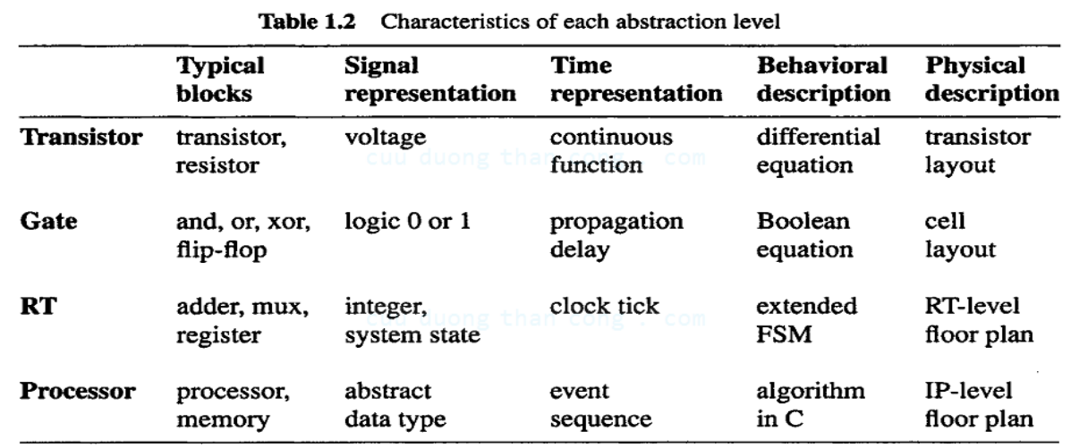
4. Levels of Abstraction

Slide 44
5. Development Tasks and EDA Software
Developing a custom digital circuit is essentially a refining and validating process.
A system is gradually transformed from an abstract high-level description to final mask layouts.
The major design tasks of developing a digital system are:
  Synthesis
  Physical Design
  Verification
  Testing

Slide 45
5. Development Tasks and EDA Software
Synthesis
  Synthesis is a refinement process that realizes a description with components from the lower abstraction level.
  The original description can be in either a behavioral view or a structure view, and the resulting description is a structural view (i.e., netlist) in the lower abstraction level.

Slide 46
5. Development Tasks and EDA Software
Physical design
  Physical deign includes two major parts.
  The first part is the refinement process between the structural and physical views, which derives a layout for a netlist.
  The second part involves the analysis and tuning of a circuit’s electrical characteristics.
  The main tasks in physical design include floor planning placement and routing and circuit extraction.

Slide 47
5. Development Tasks and EDA Software
Verification
  Verification is the process of checking whether a design meets the specification and performance goal.
  It concerns the correctness of the initial design as well as the correctness of refinement processes during synthesis and physical design.
  Verification is done in different phases of the design and at different levels of abstraction.

Slide 48
5. Development Tasks and EDA Software
Verification
  Verification has two aspects: functionality and performance.
  Functional verification checks whether a system generates the desired output response.
  Performance is represented as certain timing constraints.
  Timing verification checks whether the response is generated within the given time constraints.

Slide 49
5. Development Tasks and EDA Software
Testing
  The meanings of verification and testing are somewhat similar in a dictionary sense.
  However, they are two very different tasks in digital system development.
  Verification is the process of determining whether a design meets the specification and performance goal.
  Testing is the process of detecting the physical defects of a die or a package that occurred during manufacturing.
  When a device is being tested, we already know that the design is correct and the purpose of testing is simply to ensure that this part was properly fabricated.

Slide 50
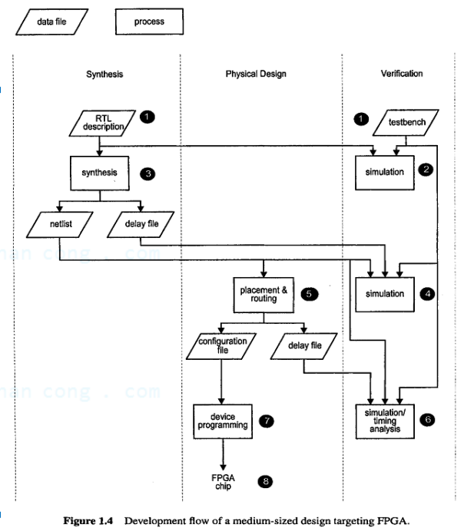
6. Flow Development

Slide 51
6. Flow Development
Develop the design file and testbench
Use the design file as the circuit description and perform a simulation to verify that the design functions as desired.
Perform a synthesis.
Use the output netlist file of the synthesizer as the circuit description and perform a simulation and timing analysis to verify the correctness of the synthesis and to check preliminary timing.
Perform placement and routing.

Slide 52
6. Flow Development
Annotate the accurate timing information to the netlist and perform a simulation and timing analysis to verify the correctness of the placement and routing and to check whether the circuit meets the timing constraints.
Generate the configuration file and program the device
Verify operation of the physical part.

